Slide 1

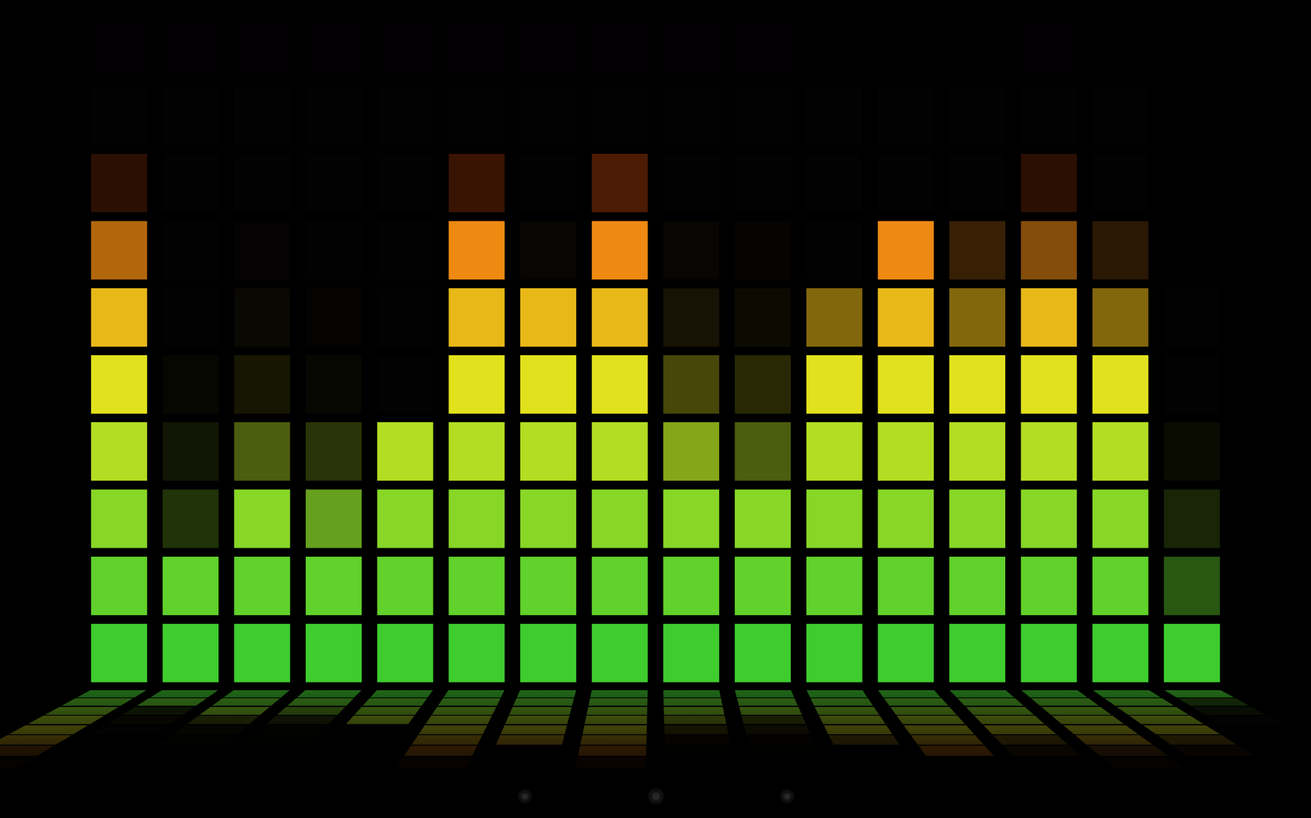

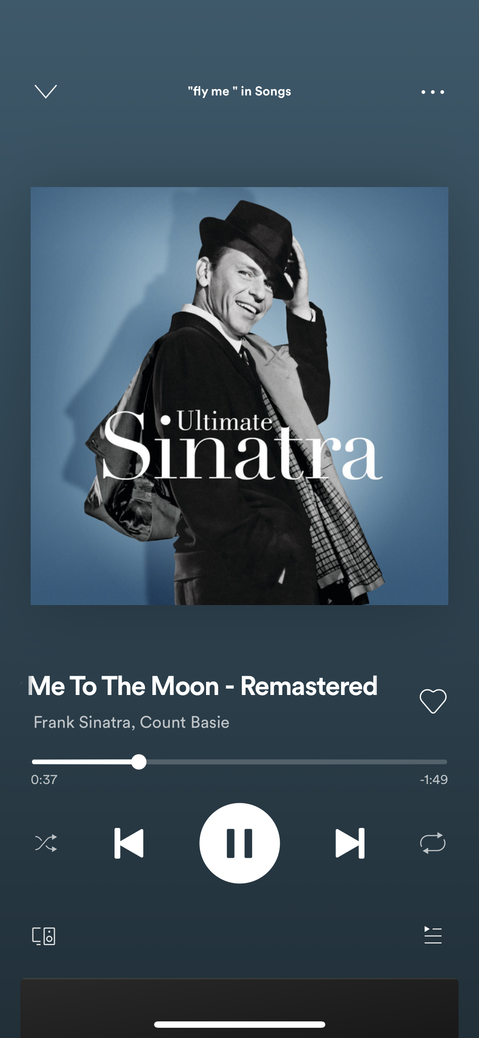
Smart Music Interface Display (S.M.I.D.)
ECE 441 Major Design Project
Proposal Presentation

Slide 2





Our Team
Cameron Haley
B.S. Computer Engineering
Anthony Banuelos B.S. Computer and Cybersecurity Engineering
Colin Prochnow
B.S. Computer and Cybersecurity Engineering
Kamil Kaczmarczyk
B.S. Computer Engineering

Slide 3
Outline
Alternative Idea Considered
Our Project
Technical Challenges
Next Steps

Slide 4

Alternative Idea Considered

Slide 5
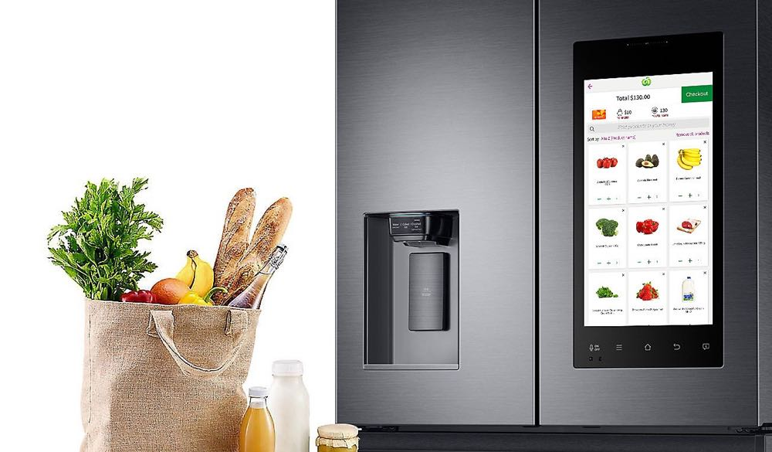
Smart Fridge
Requirements:
UPC lookup API could be a limitation
2 Power Supplies
Barcode scanner vs a normal camera
Decided to use actual barcode scanner
Issue with placement of scanner?
How to differentiate going in and out?
Would need some kind of switch/button
Could also have two separate scanners, but that would be bulkier
How to attach the sensors/raspberry pi?
How to power raspberry pi or even the display if added?
Do we want a display which can verify the product being scanned?
How are we going to interact with this display? Prompt the application? Touchscreen display?
Feels very software-heavy, the only hardware is a RPi and a scanner (and maybe a display)
Kamil

Slide 6

Our Project

Slide 7
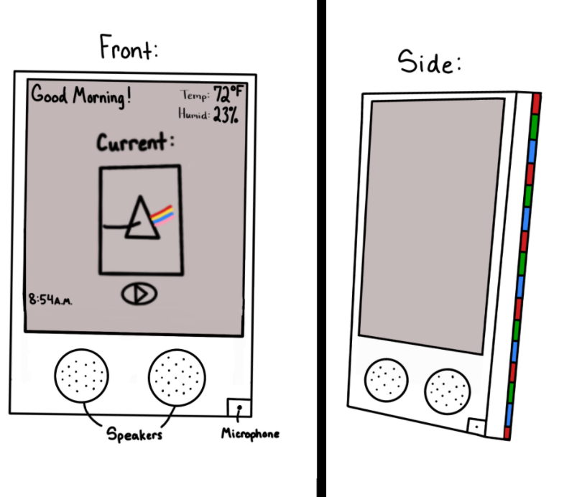
Smart Music Display
A Bluetooth smart speaker/mirror with a detailed, music-centric GUI for a richer listening experience

Slide 8
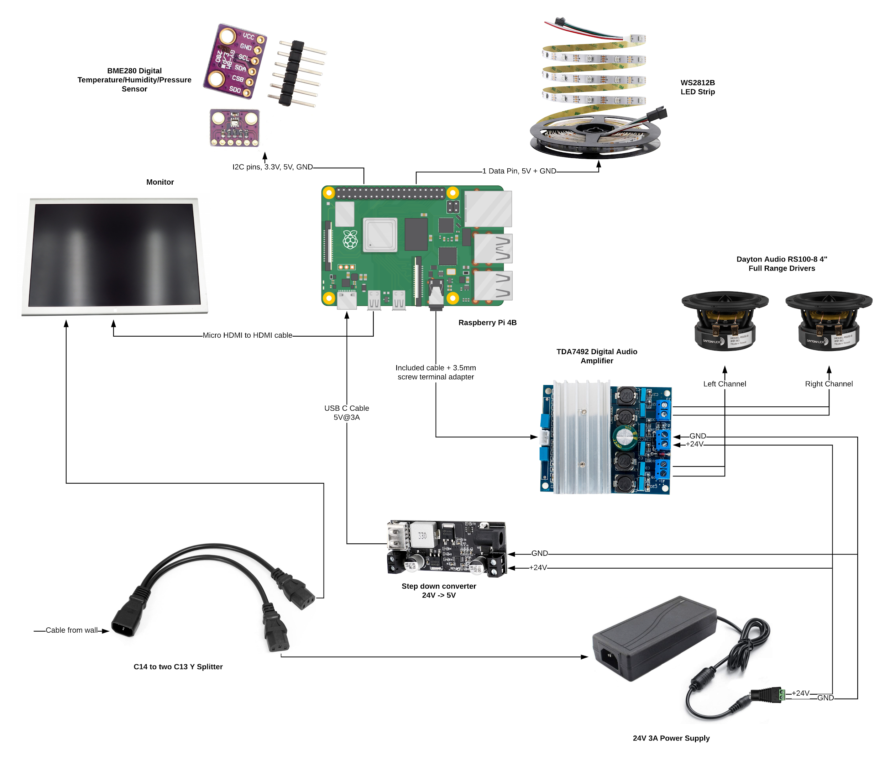
Smart Music Display
Colin
Electronics & Circuit Design
We chose the Raspberry Pi 4B for its Bluetooth 5.0 capability. It will allow us to interface with the sensors along with allowing control of the LED strips and other components of the smart mirror.

Slide 9
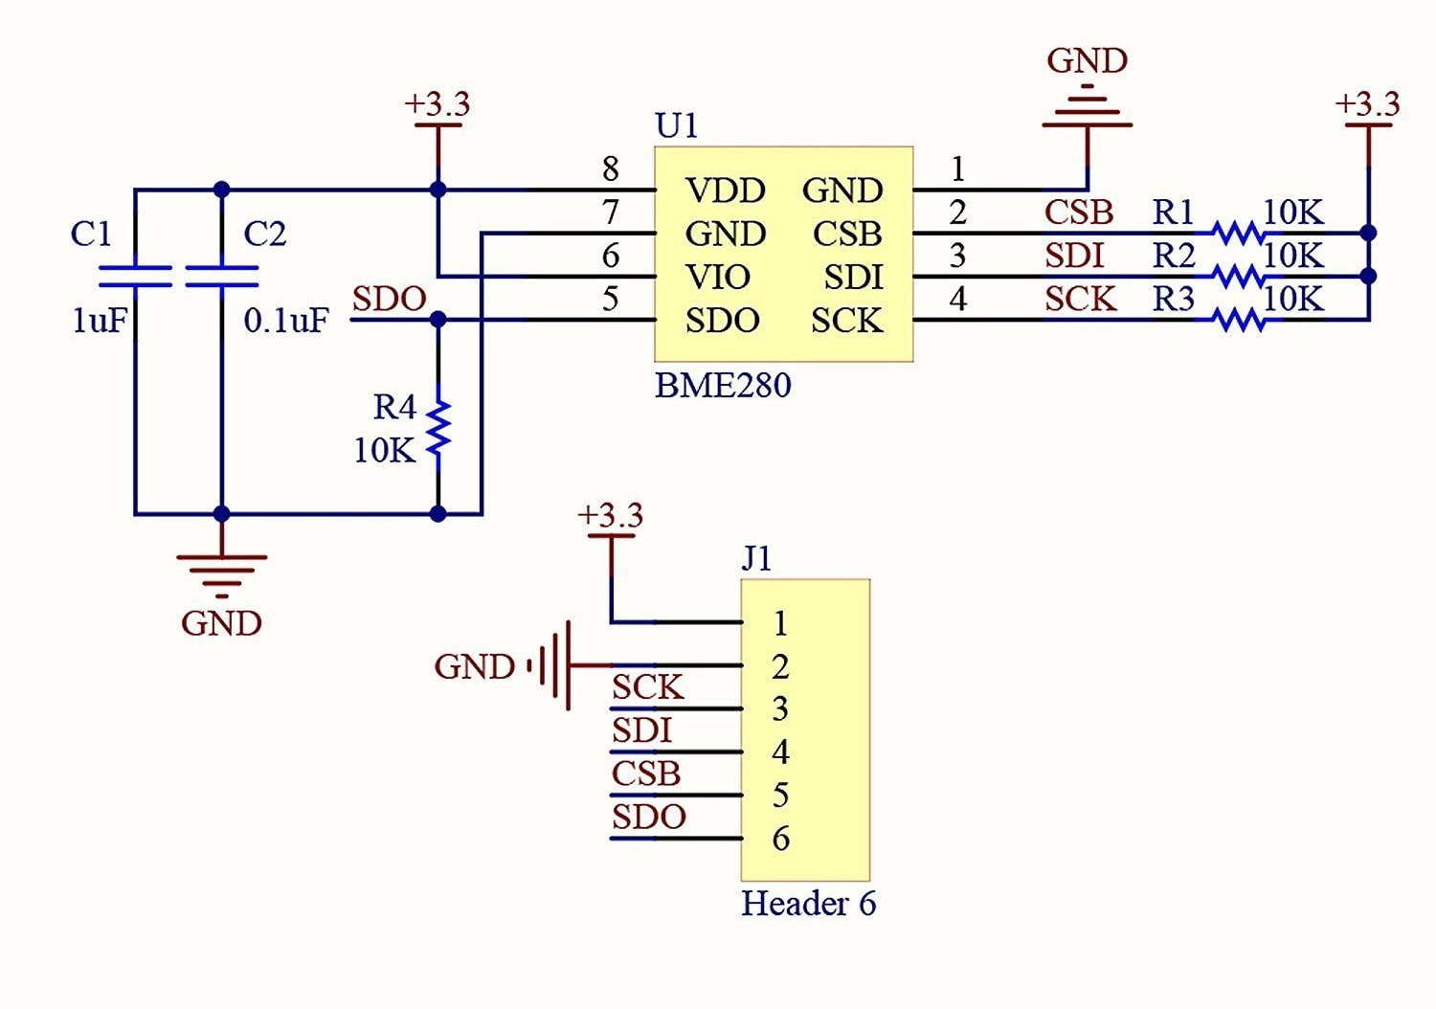
Smart Music Display
Colin
Kamil
LEDs
WS2812B
Individually addressable
Ex: Sync to beat of music
Raspberry Pi as controller
GPIO pins
Also supply 5V and GND over GPIO pins
PyAudio library
Digital signal processing using Fast Fourier transform
Sensors
BME280
atmospheric pressure, temperature and humidity sensor
Sensor might be too close to Raspberry Pi when measuring Temperature
Could use SSH client
Python Library AdaFruit_CircuitPython_BME280

Slide 10
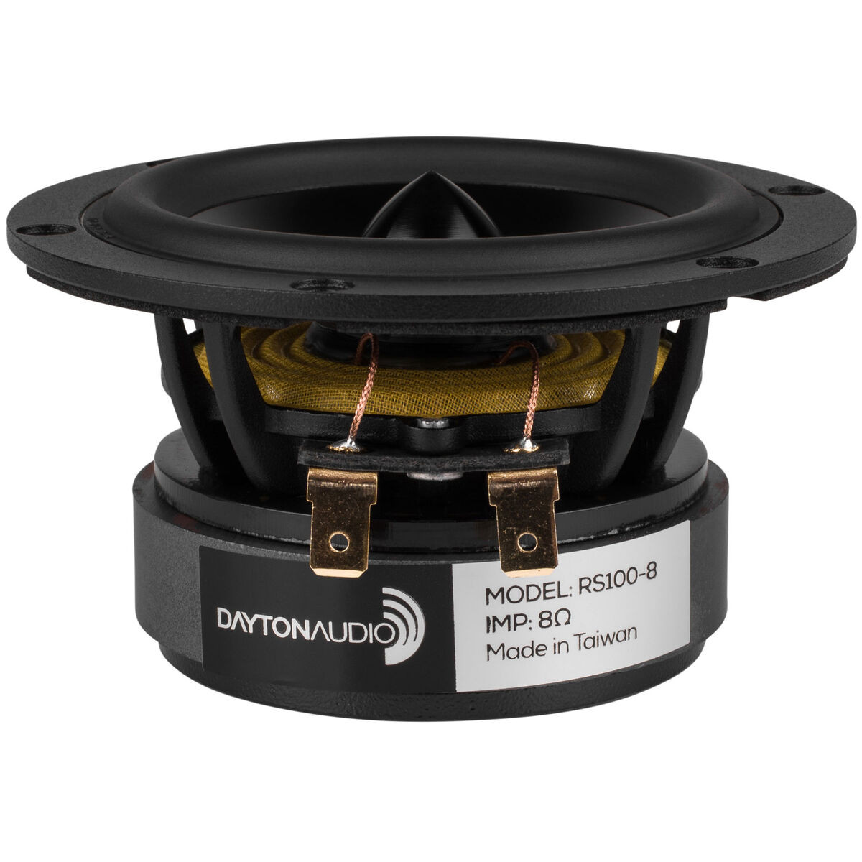
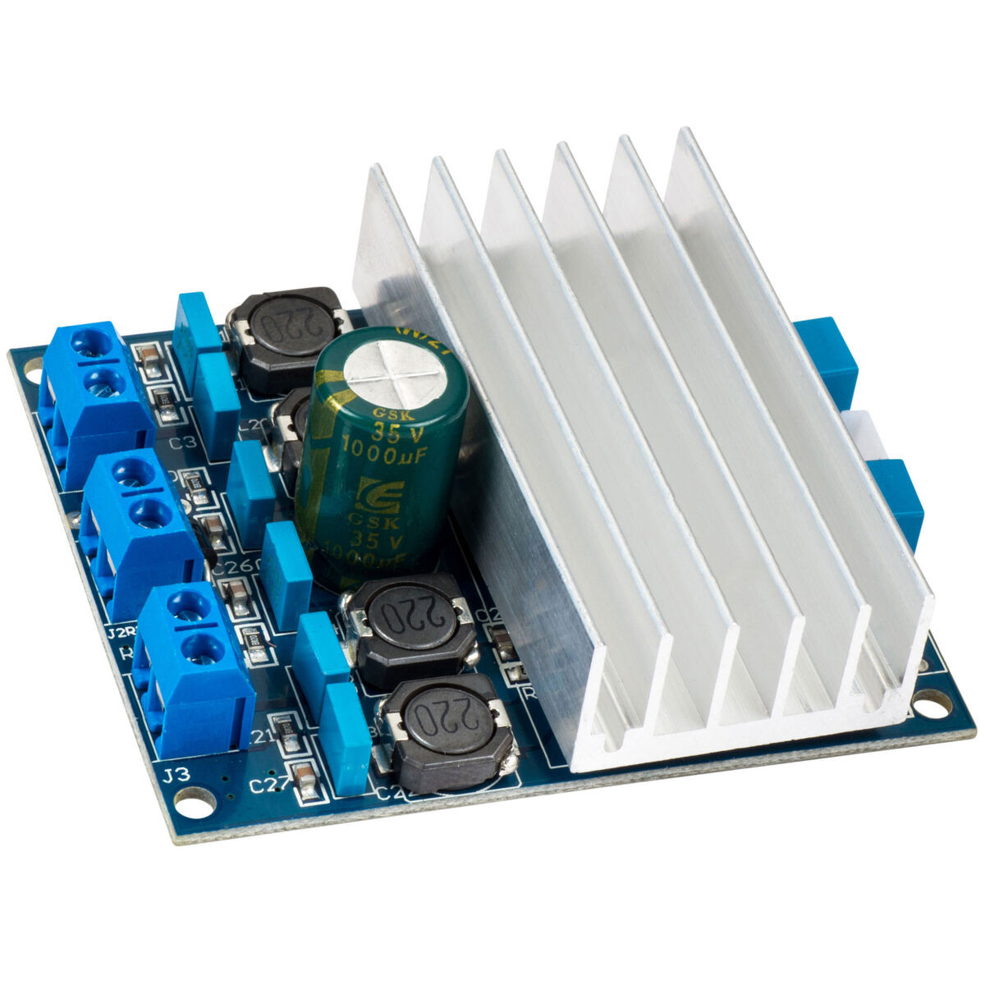
Smart Music Display
Cameron and Anthony
Audio
Two RS100-8 4” full-range speakers, powered by a TDA7492 Class D amplifier.
May add port tubes and sound dampening if necessary
Pictures courtesy of https://www.parts-express.com/

Slide 11

Smart Music Display
Colin and Anthony
Bluetooth
We will incorporate the BlueAlsa backend in order to manage the bluetooth connection held on the Raspberry Pi 4B via Bluetooth 5.0.
Picture courtesy of https://www.bluetooth.com/

Slide 12
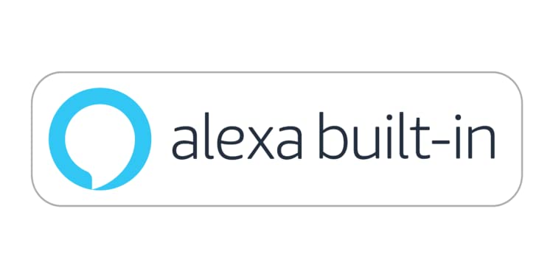
Smart Music Display
Cameron
Voice Recognition
We will use Alexa Voice Services (AVS) to provide playback control, lighting control, power control, and more via voice commands. This is what will make the speaker “smart” - it will essentially function as an Alexa device.
Picture courtesy of https://www.amazon.com

Slide 13
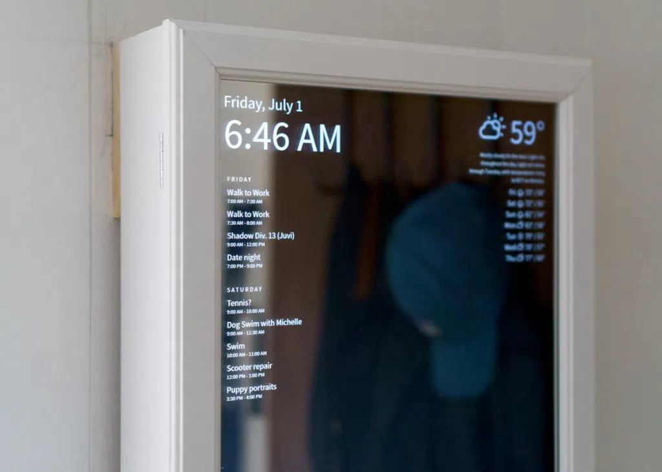
Smart Music Display
Kamil and Anthony
Display
A 23” computer monitor with a two-way mirror* in front of it to give it a “smart mirror” look.
*Two-way mirror will actually be constructed out of an ordinary glass panel with two-way film on top to conserve costs.
Picture courtesy of https://www.aesdes.org/2017/03/14/prototype-design-review-smart-mirror/

Slide 14
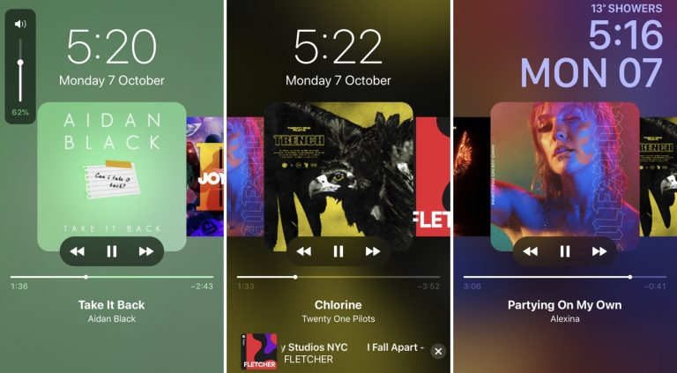
Smart Music Display
Cameron
Graphic User Interface
While a Bluetooth device is connected, standard “currently playing” graphics will be shown (title, artist, album art, etc.). Additionally, we will show info from the sensors (temperature, humidity, pressure).
Will use ElectronJS and web technologies to build UI.
Picture courtesy of https://www.idownloadblog.com

Slide 15
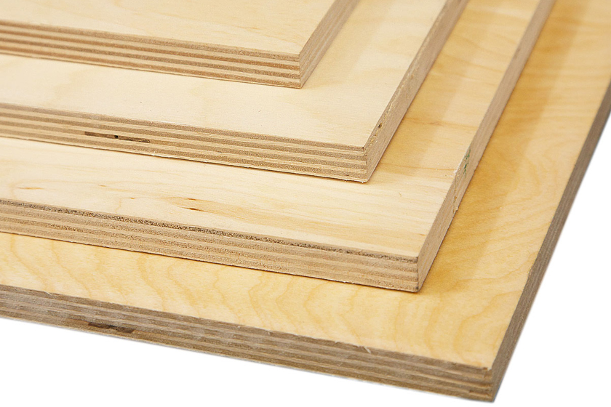
Smart Music Display
Anthony, Kamil, and Colin
Frame
½ inch plywood
Cabinet for audio equipment
Notch where the glass will sit
Two-way film on glass
Cheaper than buying two-way glass outright
Plank courtesy of https://www.woodworkerssource.com/

Slide 16
Technical Challenges
Bluetooth Connection Pulling currently playing information Security aspects - prevent just anyone from connecting to speakers | Voice Commands Setting up AVS and getting it working with controlling the Bluetooth audio (Next, Pause, etc.) Controlling LEDs, sensors, display, etc. via Alexa (“Alexa, turn off the LEDs”) with Smart Home for AVS | LED Synchronization Intercepting Bluetooth audio to perform processing Processing data efficiently in real time (low-latency) Creating visualizations from processed data

Slide 17
Timeline
TODAY
27 Feb
6 Mar
13 Mar
20 Mar
27 Mar
3 Apr
17 Apr
Proposal
Have all necessary components tested
Basic LED control
Bluetooth connectivity & information
Speakers / Amplifier working
Enclosure assembled
Basic AVS integration
Integration Test

Slide 18
Questions?

